Slide 1

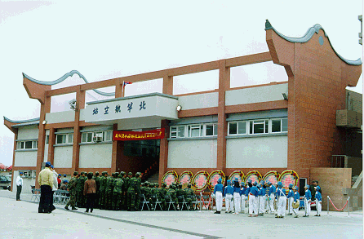
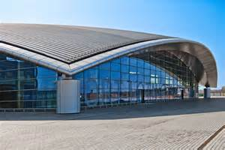
1.2 The historical development of airport terminal
Most airport terminals are built in a plain style, with the 'concrete boxes' of the 1960s and '70s generally gave way to 'glass boxes' in the '90s and '00s, with the best terminals making a vague stab at incorporating ideas of "light" and "air"'.
concrete box 混凝土箱形

Slide 2
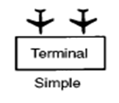

1.3 Design of Terminal
Simple Configuration
In the simple-style configuration of an airport, aircraft are parked on the apron angled either nose-in or nose-out, for self-taxi in and out. Passengers walk across the tarmac to the terminal building or to the aircraft. This design is still common among smaller airports.
Simple Configuration 简单式构型
nose-in 机头向内
Nose-out 机头向外

Slide 3
1.3 Design of Terminal
Simple Configuration
Though perhaps appropriate for small low-density airports, having passengers walking around the tarmac creates security and safety concerns, and is less convenient for passengers and their baggage.
Simple Configuration 简单式构型

Slide 4


1.3 Design of Terminal
Linear Terminal Concept
As airports expanded to meet the growing needs of the public, as well as the growing wingspans of aircraft, simple-unit terminals expanded outward in a rectangular or linear manner.
Linear Terminal 线型航站楼

Slide 5
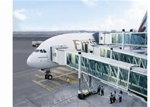
1.3 Design of Terminal
Linear Terminal Concept
The advantages of the linear terminal configuration include:
the simple access from the Terminal buildings to the airplanes,
a simple installation of the passenger loading bridges
sufficient space for technical handling equipment and staff at the level of the terminal
passenger loading bridges

Slide 6
1.3 Design of Terminal
Linear Terminal Concept
One of the main disadvantages of linear terminals becomes evident as the length of the terminal building increases. Walking distances between facilities, particularly distantly separated gates, become excessive for the passenger whose itinerary requires a change in aircraft at the airport.

Slide 7


1.3 Design of Terminal
Curvilinear Terminal Concept
In some instances airports were extended in a curvilinear fashion, allowing even more aircraft to park "nose-in" to the terminal building while maintaining short walking distances from the airport entrance to the aircraft gate.
curvilinear adj. 曲线的；由曲线组成的

Slide 8
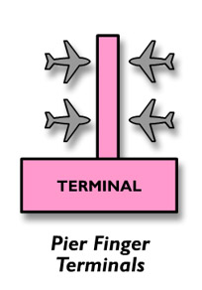
1.3 Design of Terminal
Pier Finger Terminal Concept
Aircraft are parked side-by-side along both sides of a terminal pier which juts into the apron area. In many large airports, the introduction of piers was practically the only possibility for providing a greater number of contact stands and to increase the capacity of the airport.
Pier Finger Terminal 指廊式航空站

Slide 9
1.3 Design of Terminal
Pier Finger Terminal Concept
A pier design uses a small, narrow building with aircraft parked on both sides. One end connects to a ticketing and baggage claim area. Piers offer high aircraft capacity and simplicity of design, but often result in a long distance from the check-in counter to the gate (up to half a mile in the cases of Kansai International Airport or Lisbon Portela Airport's Terminal 1).
Pier Finger Terminal 指廊式航空站

Slide 10
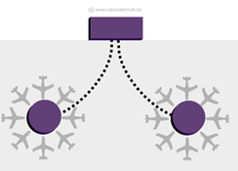
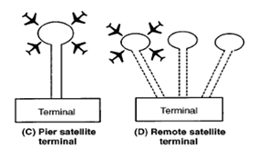
1.3 Design of Terminal
Satellite Terminal Concept
In this concept, aircraft are parked all the way around a satellite terminal from the main terminal, and connected with the main terminal building by underground tunnels or by overhead corridors.
Satellite Terminal 卫星厅式航站楼

Slide 11
Satellite Terminal Concept
1.3 Design of Terminal
Satellite Terminal Concept
The satellites may be any shaped from linear as at Atlanta Hartsfield to circular as with Charles de Gaulle Terminal One.
Typically, the number of stands at circular satellites varies between 4 to 8 airplanes but the linear ones may have 20 stands per side.
Satellite Terminal 卫星厅式航站楼

Slide 12

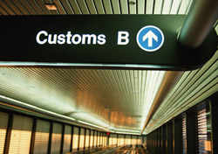
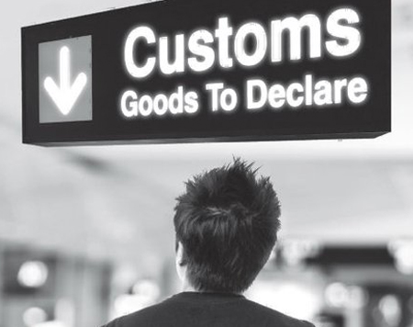
2.1 Zones in a Terminal
Customs
What kind of airport have customs procedure?

Slide 13
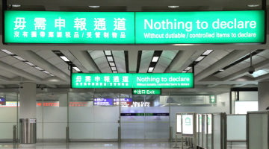
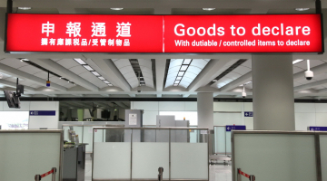
2.1 Zones in a Terminal
customs
Red and green channels
In some countries, customs procedures for arriving passengers at many international airports and some road crossings are separated into red and green channels.
Passengers with goods to declare (carrying items above the permitted customs limits and/or carrying prohibited items) go through the red channel.
Passengers with nothing to declare (carrying goods within the customs limits only and not carrying prohibited items) go through the green channel. These passengers are subject only to spot checks to save time.
red channel 红色通道/申报通道
green channel 绿色通道/无需申报通道

Slide 14
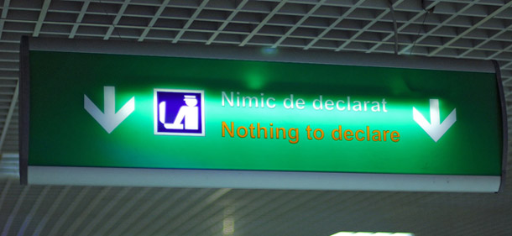
2.1 Zones in a Terminal
customs
Red and green channels
However, if a passenger going through the green channel is found to be carrying goods above the customs limits or prohibited items, he or she may be prosecuted for making a false declaration to customs, by virtue of having gone through the green channel.
red channel 红色通道/申报通道
green channel 绿色通道/无需申报通道

